Slide 1
Portfolio for Joseph Legacy
May-2013

Slide 2
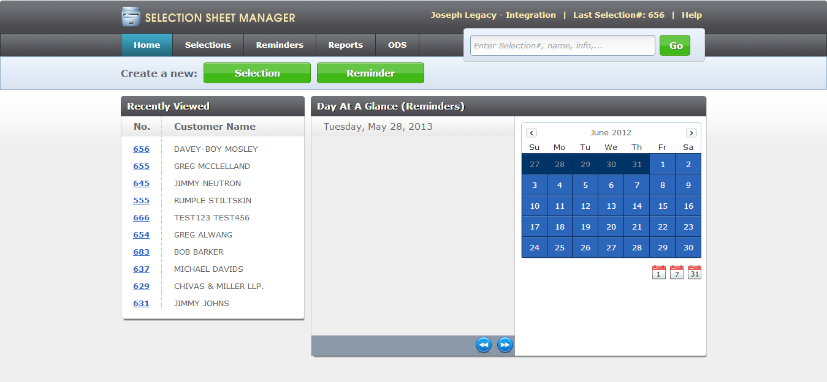
Example #1 - Mobile Web App
Target - IPAD,Galaxy S3, and Desktop
Technology – JavaScript, JavaScript MVC, jQuery, CSS, HTML, and EJS Templates Front-end
Info - Initial Sign On Screen - Calendar is jQuery Plugin
** I have additional screens that I can show if needed.

Slide 3
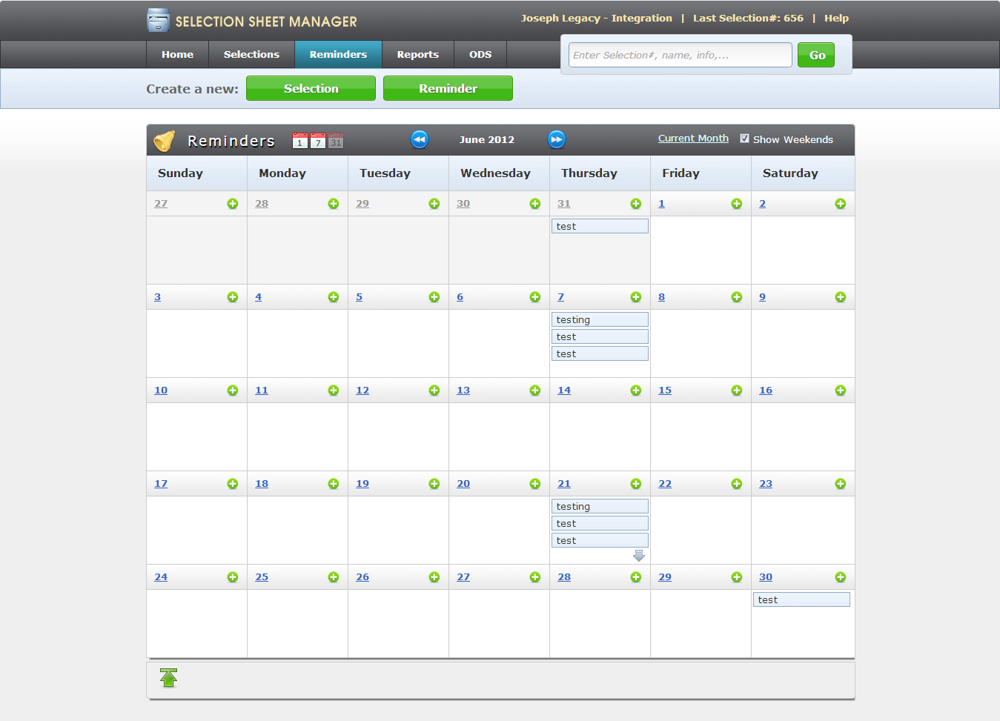
Example 2# - Custom Calendar with Links/Actions
- Uses jQuery/JavaScript for all links and actions.

Slide 4
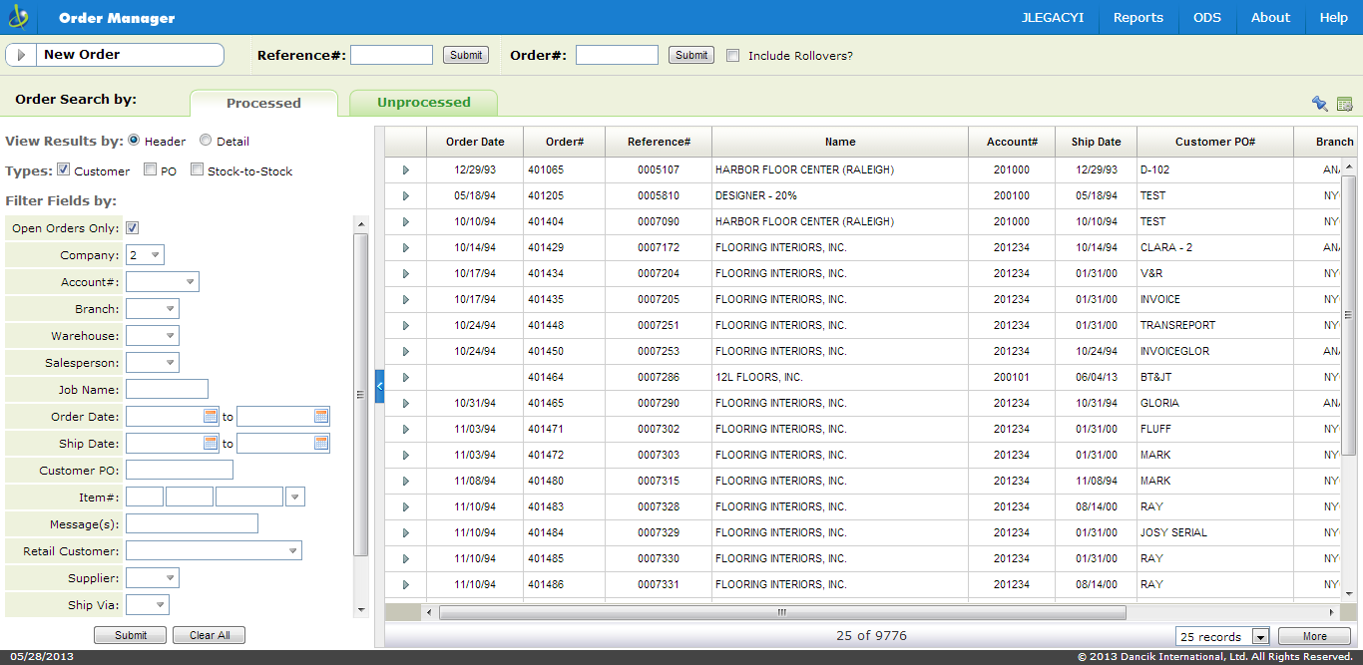
Example #3 – Web Application with Grid Presentation
- All Visual content/behavior controlled by JavaScript/jQuery/CSS

Slide 5
Example - #4 - Code Taken from a View.
- This is an example of how we render a view.
// ------------------------------------------------------------
// -- Function : initWeekPage
// ------------------------------------------------------------
initWeekPage: function(target, results, data) {
var _this = this;
_this.results = results;
_this.data = data;
var btnActive;
// get accompanying month data to fill in calendar
_this.getCalendarData(_this.data);
target.html($App.Template("dashboard/createNewHeader.ejs").render());
target.append($App.Template("reminders/week.ejs").render(_this.results, _this.data));
…....
//append reminders to calendar//
$.each(results, function(index, value) {
$.each(value, function(idx, keyvalue) {
var dayNumber = "#" + parseInt(keyvalue.m, 10) + '-' + parseInt(keyvalue.d, 10),
link = '<a href="#openReminder/' + keyvalue.id + '" class="ssm-link">' + keyvalue.brief + '</a>';
$(dayNumber).append("<div class='ssm_weekview_detail_link'>" + link + "</div>");
$(dayNumber).append('<div class="ssm_divider"></div>');
$(dayNumber).find('a').data('payload', {
ssm_ForDate: keyvalue.m + '/' + keyvalue.d + '/' + (keyvalue.y % 100)
});
});
});
data.mode = 'current';
$App.Fire('openRemindersWeek', data);
});
},

Slide 6
Example - #5 Code Taken from a Model.
- This example of how we make model calls. Call is made to WebService, data returned is JSON.
(function ($) {
$App.Model.Extend('SSM.Ajax', 'ItemSearch', {
initialize: function () {
this._super();
},
getItems : function (data, callback, errorCallback) {
var _this = this;
_this.post(data, '../../dancik-aws/des/getItems',function (results) {callback(results);},errorCallback);
}
});
})(jQuery);

Slide 7
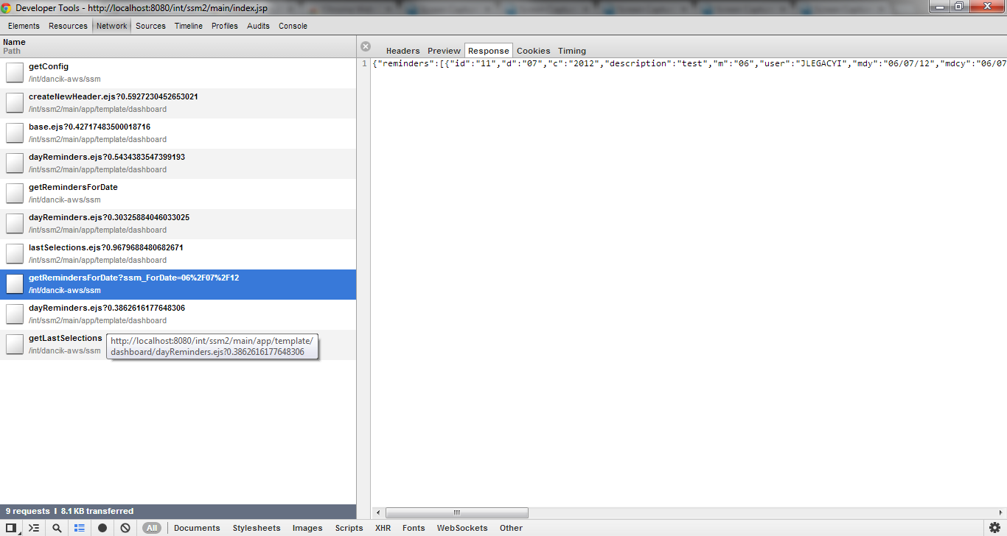
Example - #6 – Passing of Data To/From Back-end
- Chrome developer tools showing actual call to Back-end with data returned in response.

